Slide 1




Scientific Communication
Phuc Loi Luu, PhD
Email: Luu.p.loi@googlemail.com
Zalo: 0901802182
Sept 20 2025

Slide 2
Content
Class member introduction
Curriculum of Introduction to Scientific Communication 2025
Evalutation for the course
What is Scientific Communication?
What's the difference between a magazine and a journal?
Scientific Publishing Workflow
Projects and important dates

Slide 3

Classmate Introduction
Bạn phẻ không?
Phẻ! Cảm ơn bạn. Còn bạn?

Slide 4
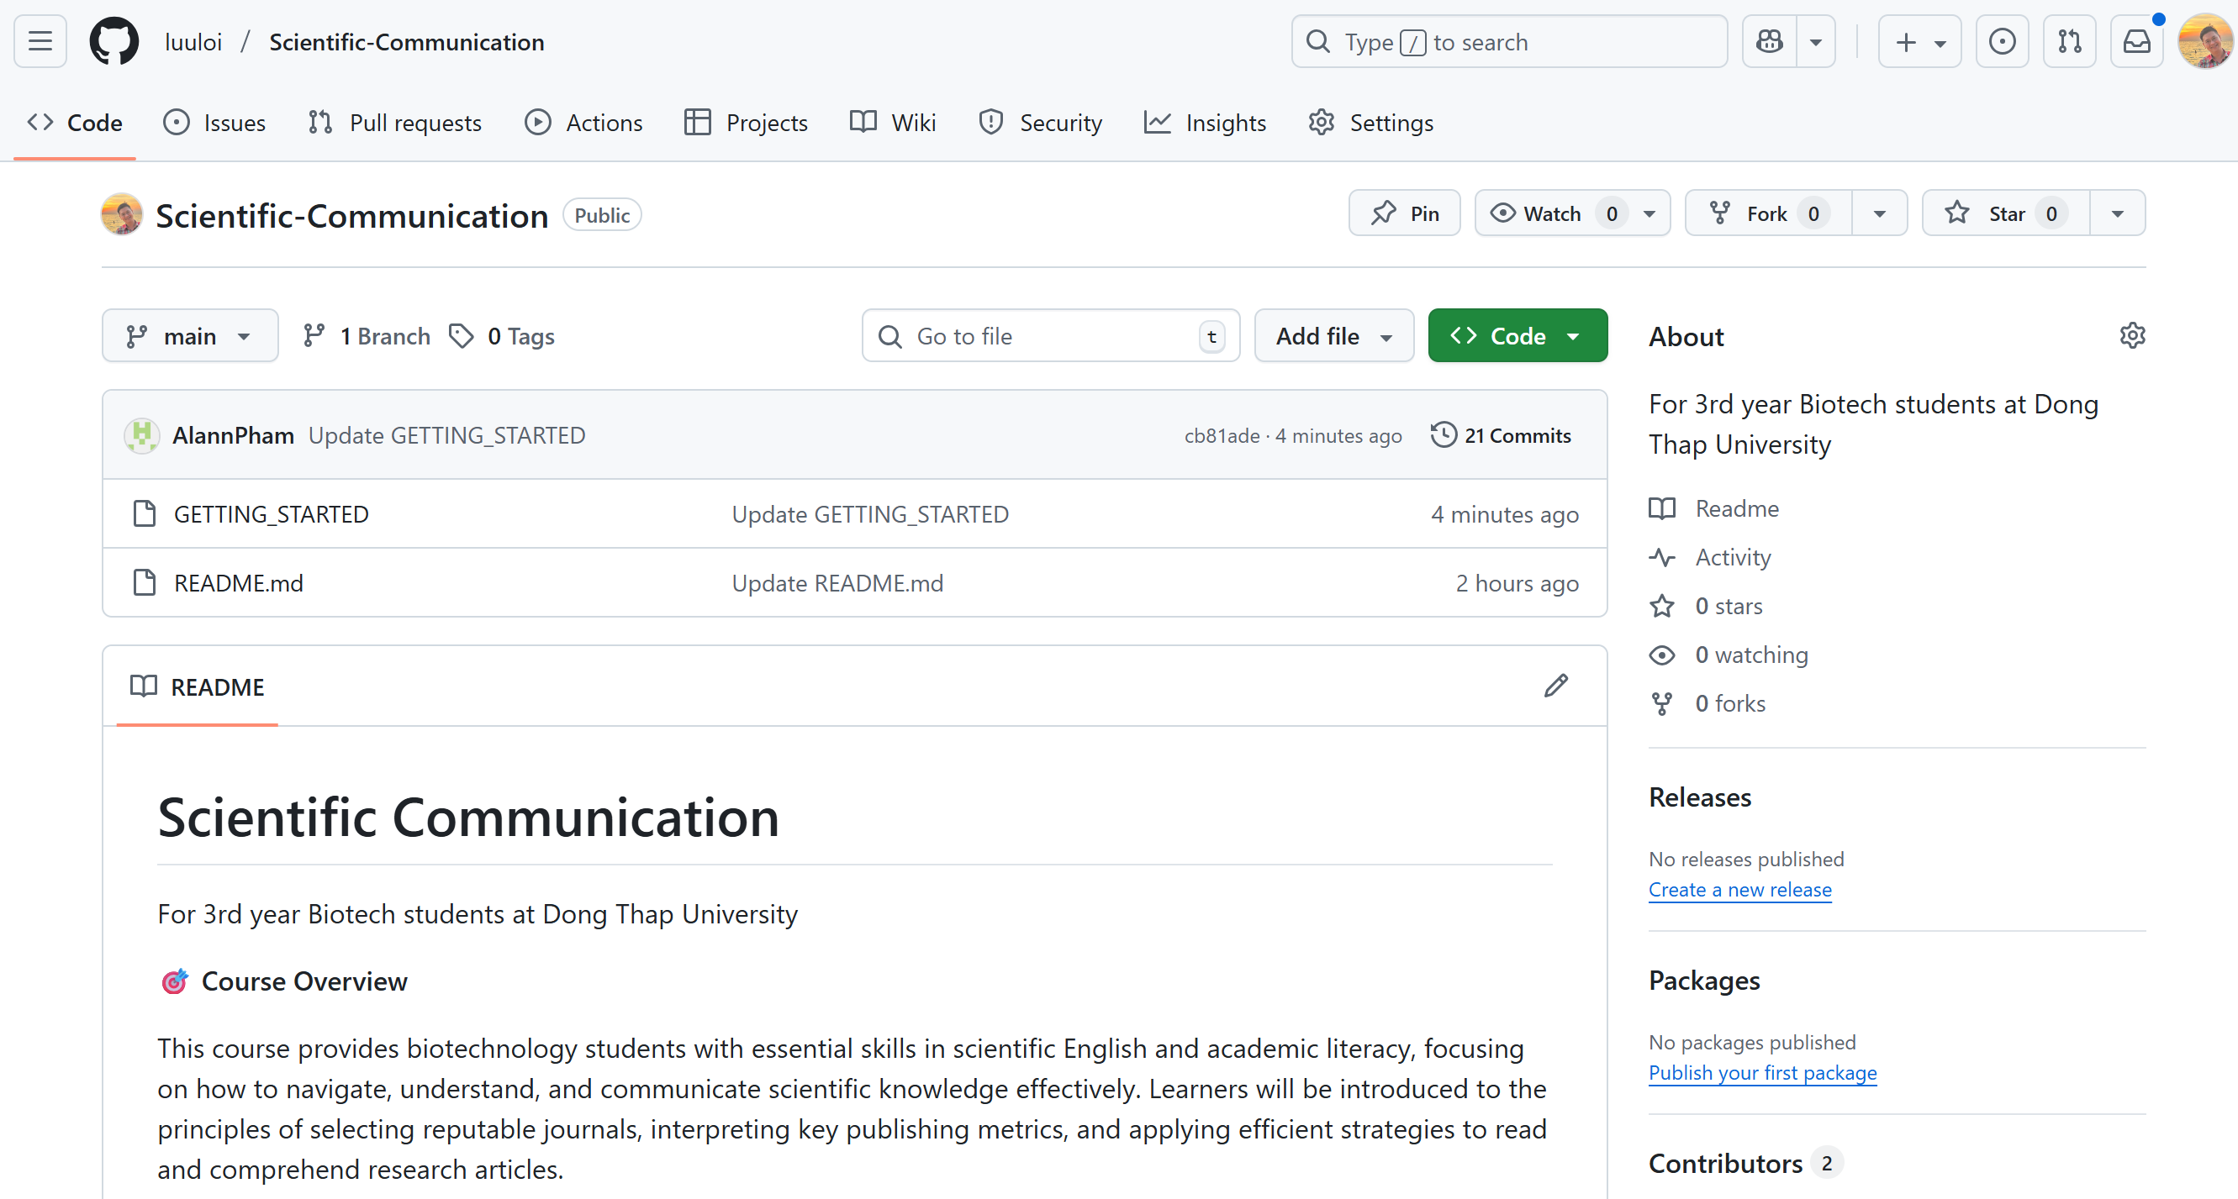
https://github.com/luuloi/Scientific-Communication
Curriculum of Introduction to Scientific Communication 2025

Slide 5
Evalutation for the course
Bạn 1: chuẩn bị poster (10 phút trình bày online, dạng slide)
Bạn 2, 3, 4: chấm điểm sau khi mỗi bạn hỏi 1 câu hỏi cho bạn 1
Điểm cuối kỳ của bạn 1 = 10% (bạn 2) + 10% (bạn 3) + 10% (bạn 4) + 50% (tôi) + 20% (tôi: cho quyển bài tập lớn nộp lại)
Điểm giữa kỳ của bạn 2 = 100% câu hỏi bạn 2 hỏi bạn 1 (tôi)
Điểm cuối cùng = (điểm giữa kỳ + 2 * điểm cuối kỳ)/3

Slide 6
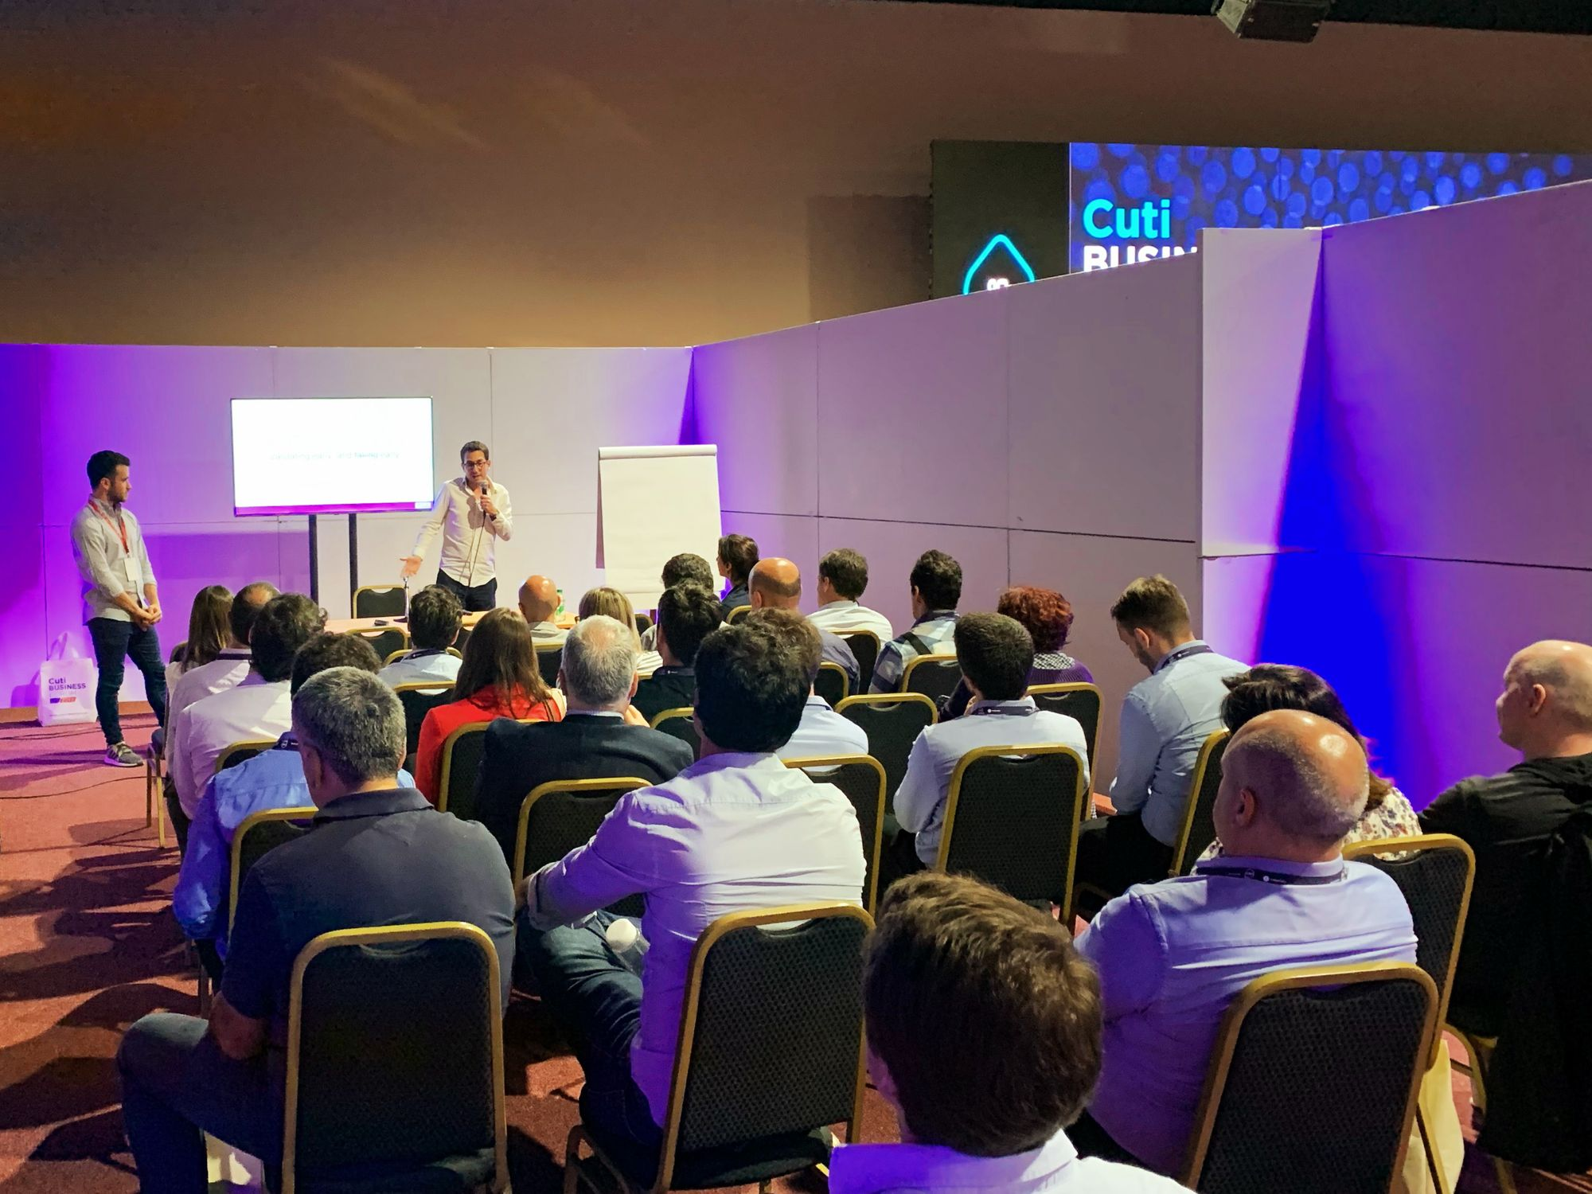
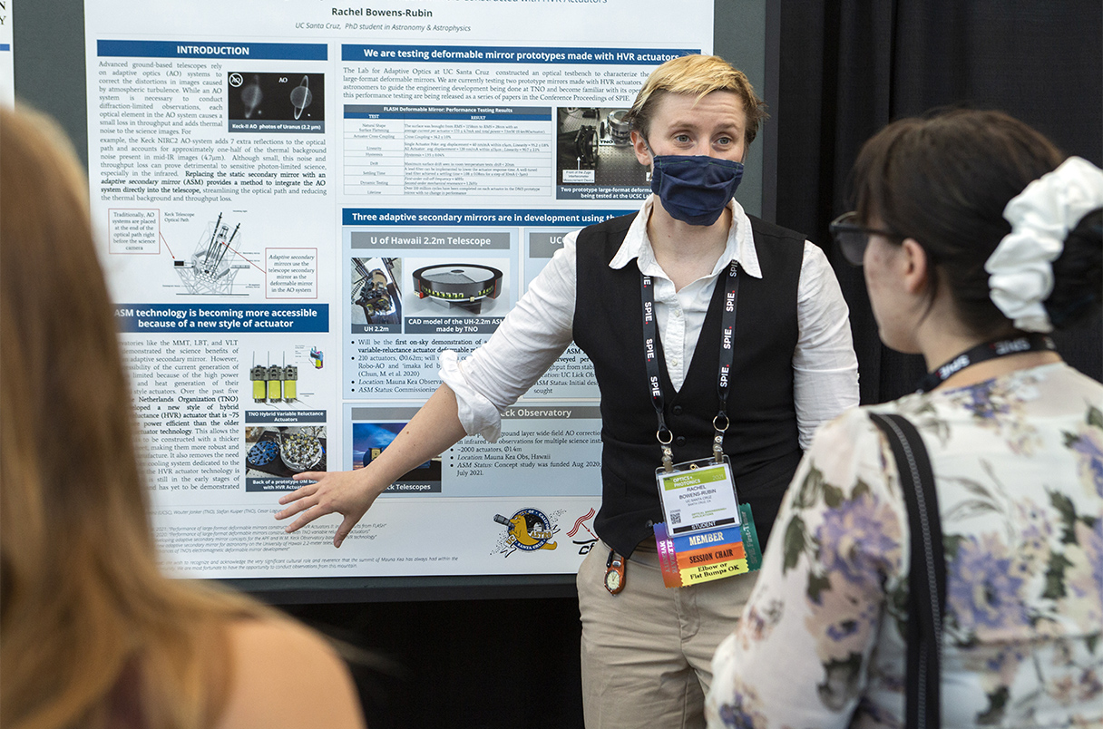
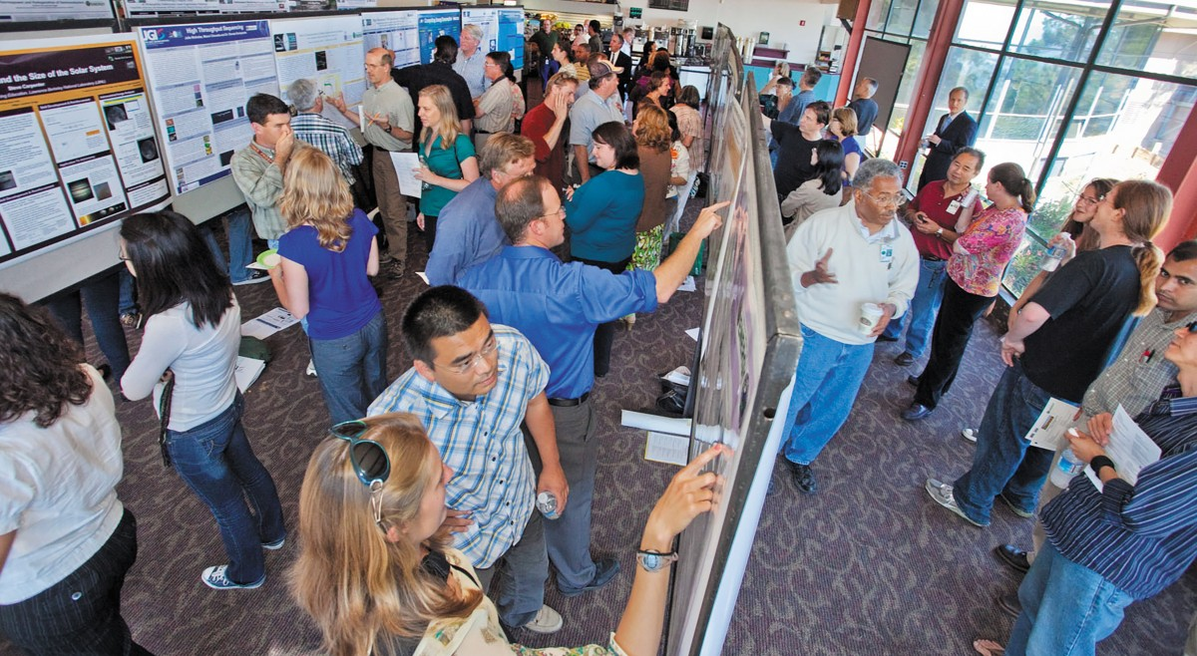
Scientific communication
Audience = listen
Poster presentation = write + speak
Oral presentation = talk = speak + write
Preparing manuscript = write

Slide 7
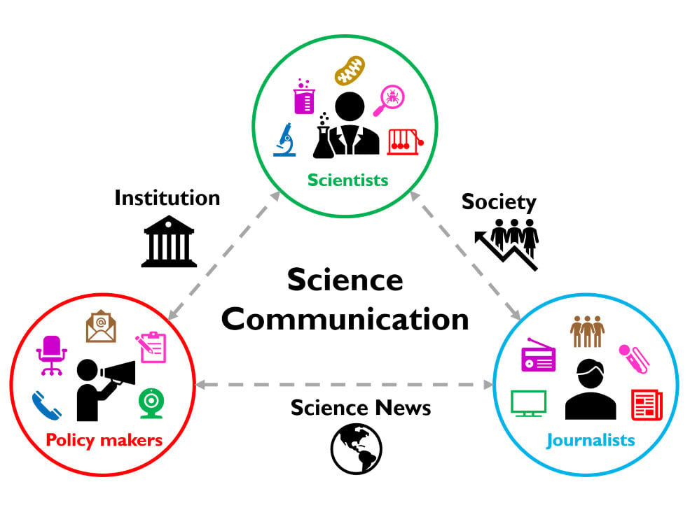
https://crosstalk.cell.com/blog/bringing-a-scientists-purpose-to-life

Slide 8
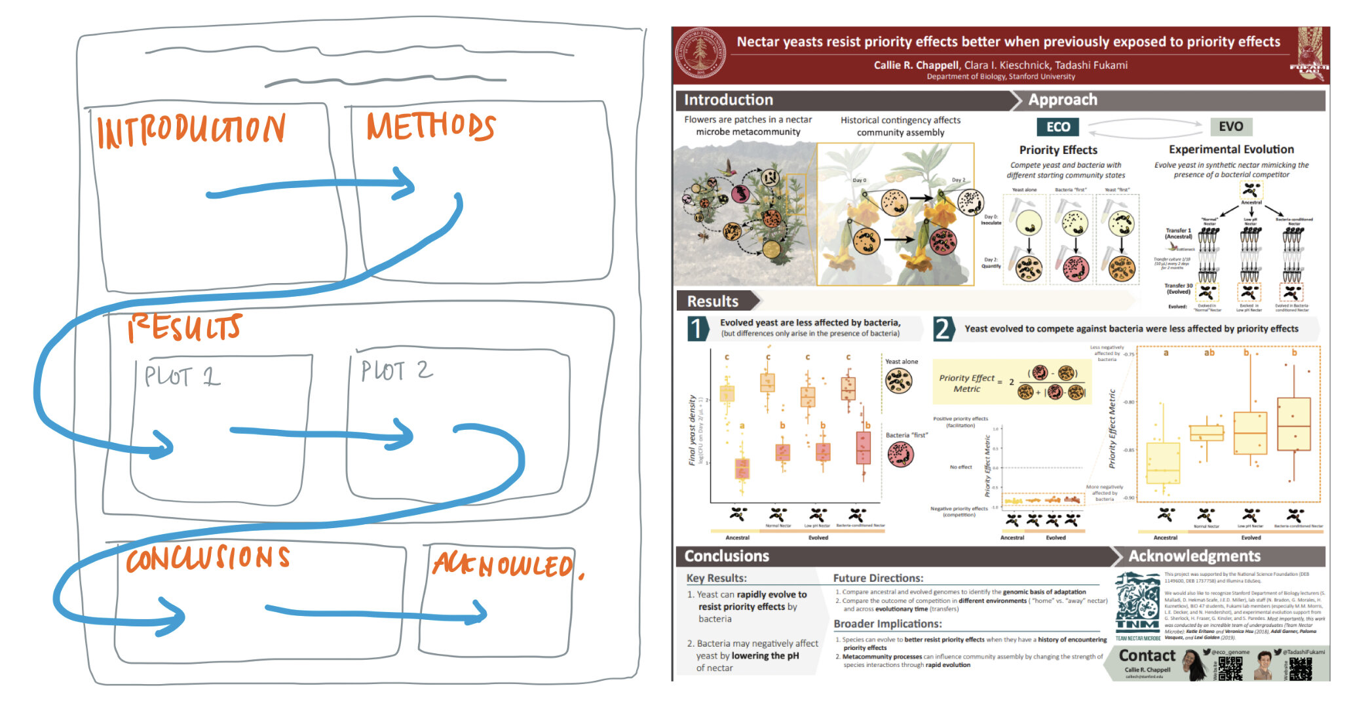
Scientific Research Poster
https://www.calliechappell.com/blog/scientific-poster

Slide 9

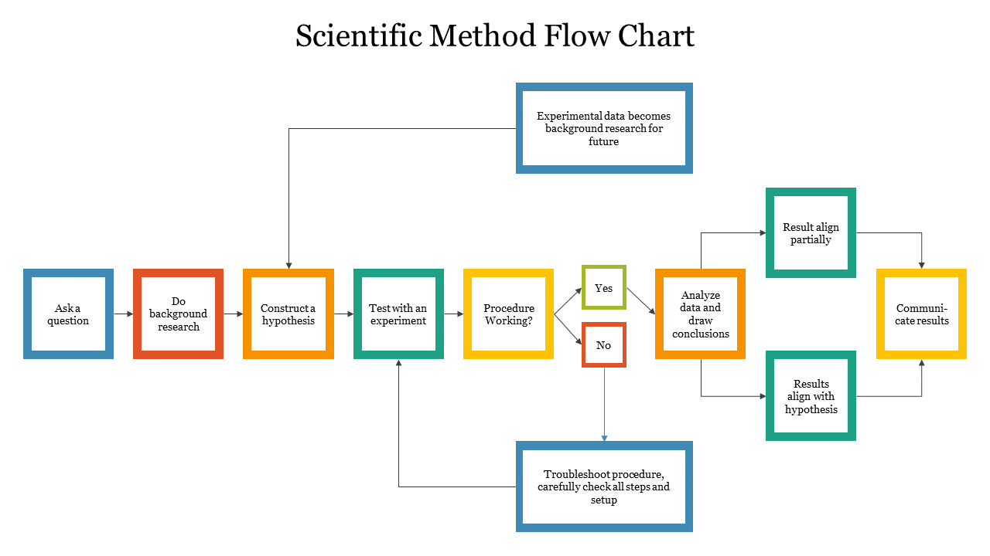
Scientific Research Oral Presentation
https://www.slideegg.com/scientific-method-flow-chart
https://thesislink.aut.ac.nz/?p=10499

Slide 10
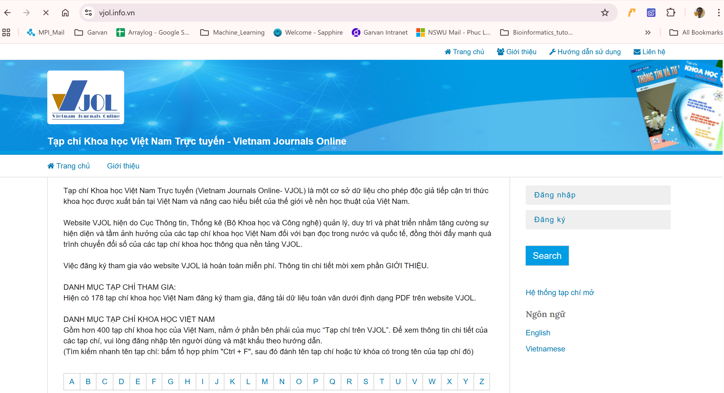
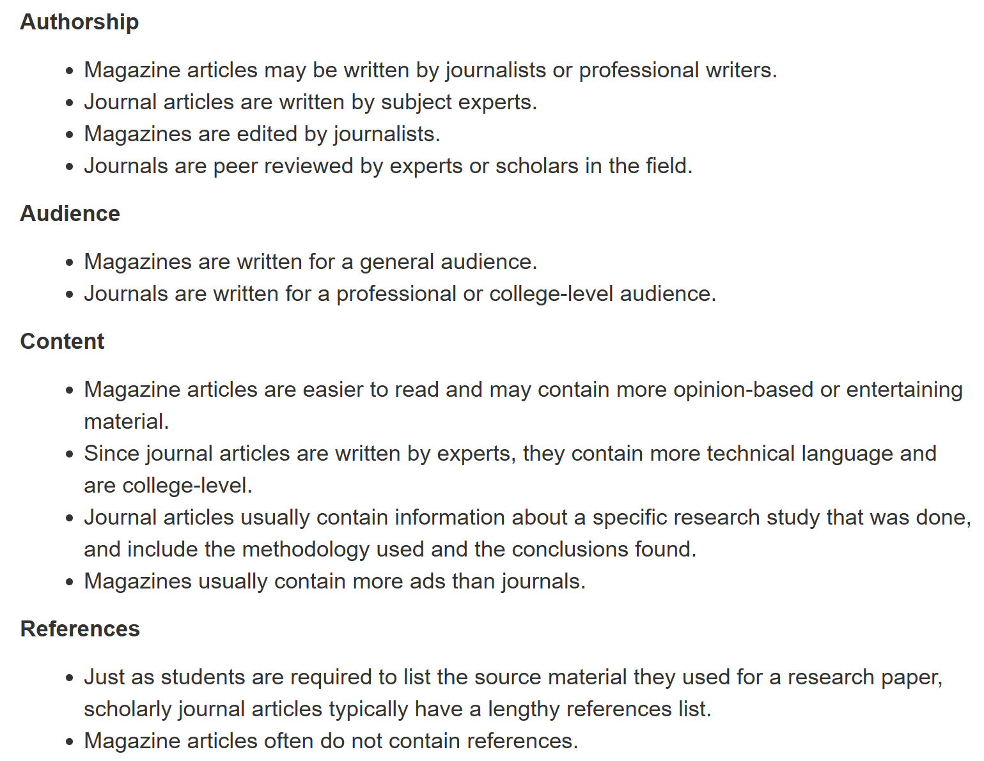
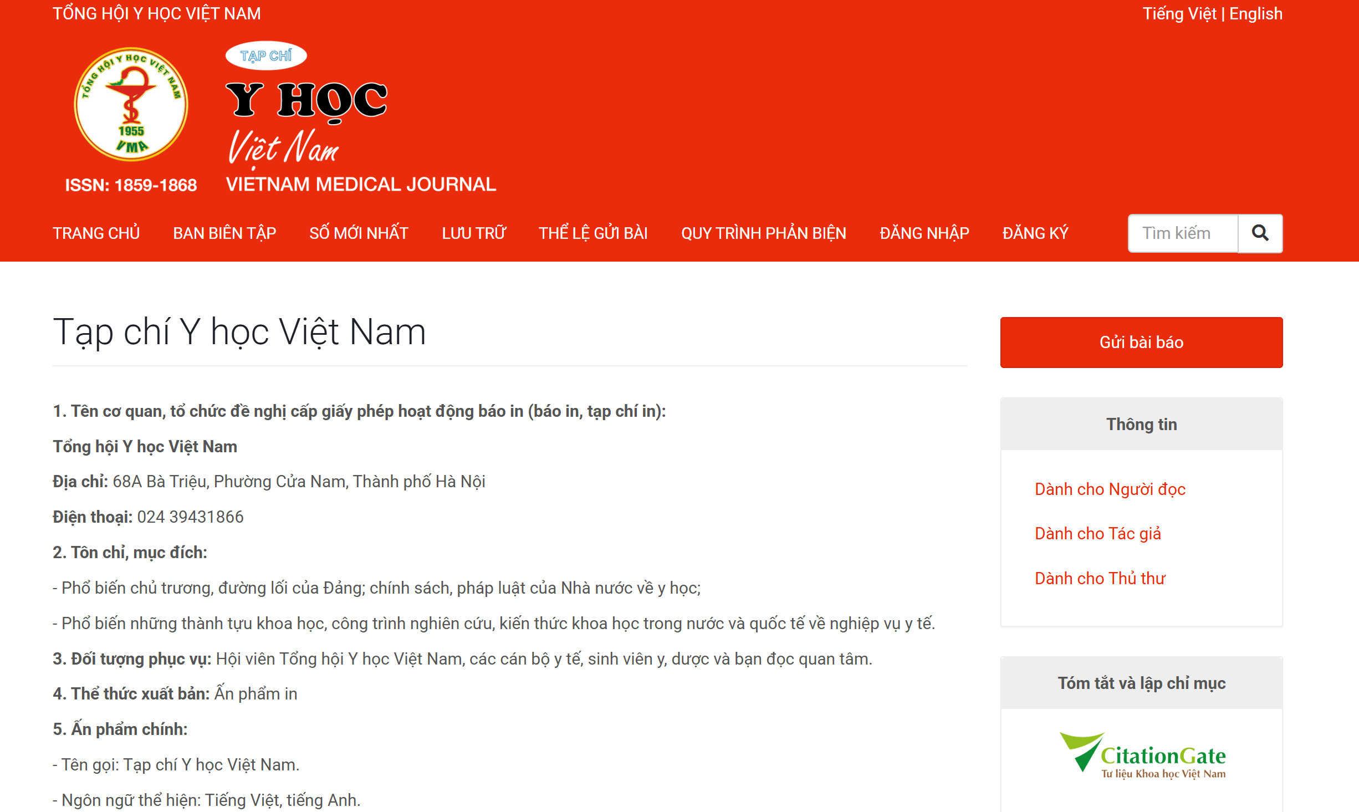
What's the difference between a magazine and a journal?
https://vjol.info.vn/, https://tapchiyhocvietnam.vn/index.php/vmj
https://askus.baker.edu/faq/216945

Slide 11

Exercise 1: read the article https://cjc.edu.vn/tin-tuc-su-kien/cac-tap-chi-noi-tieng-o-viet-nam/

Slide 12
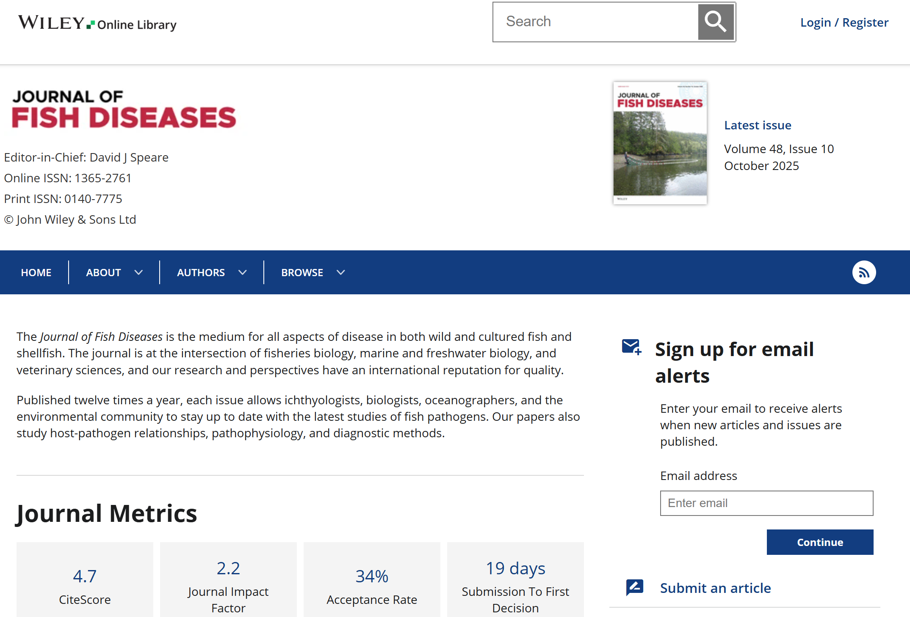
Exercise 2: look in to the detail of the journal https://onlinelibrary.wiley.com/journal/13652761

Slide 13
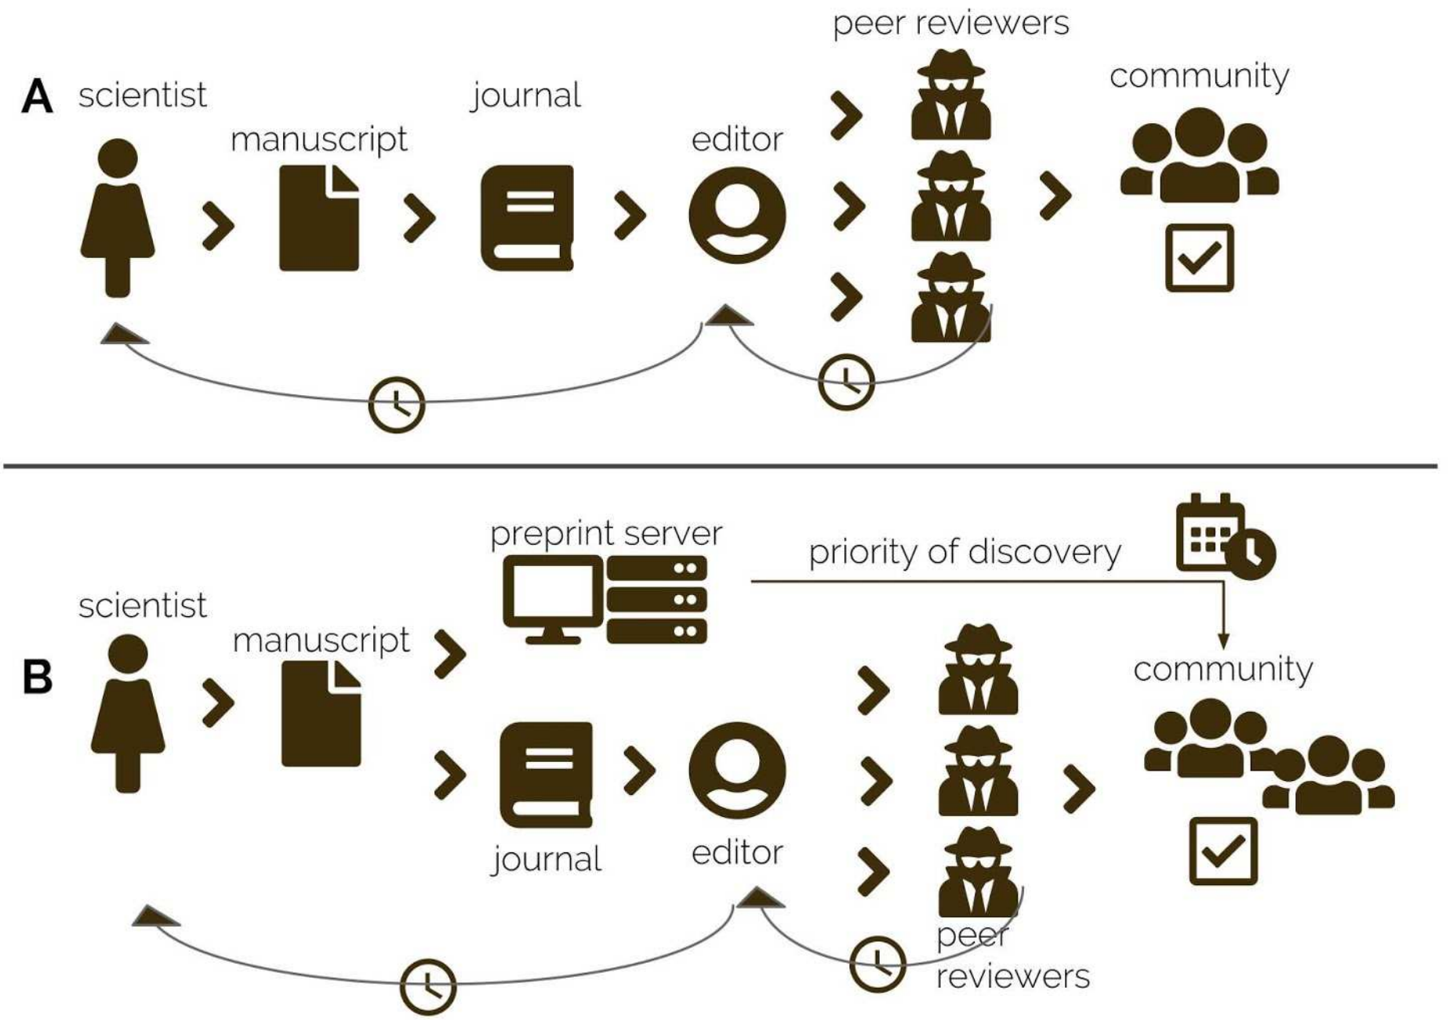
Scientific Publishing Workflow
Traditional peer review publishing workflow.
B. Preprint submission establishing priority of discovery.
https://doi.org/10.7287/peerj.preprints.27580v1

Slide 14
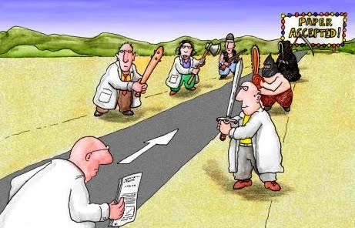
Scientific Publishing Workflow
https://blog.cureus.com/2014/03/31/blind-vs-open-peer-review/

Slide 15
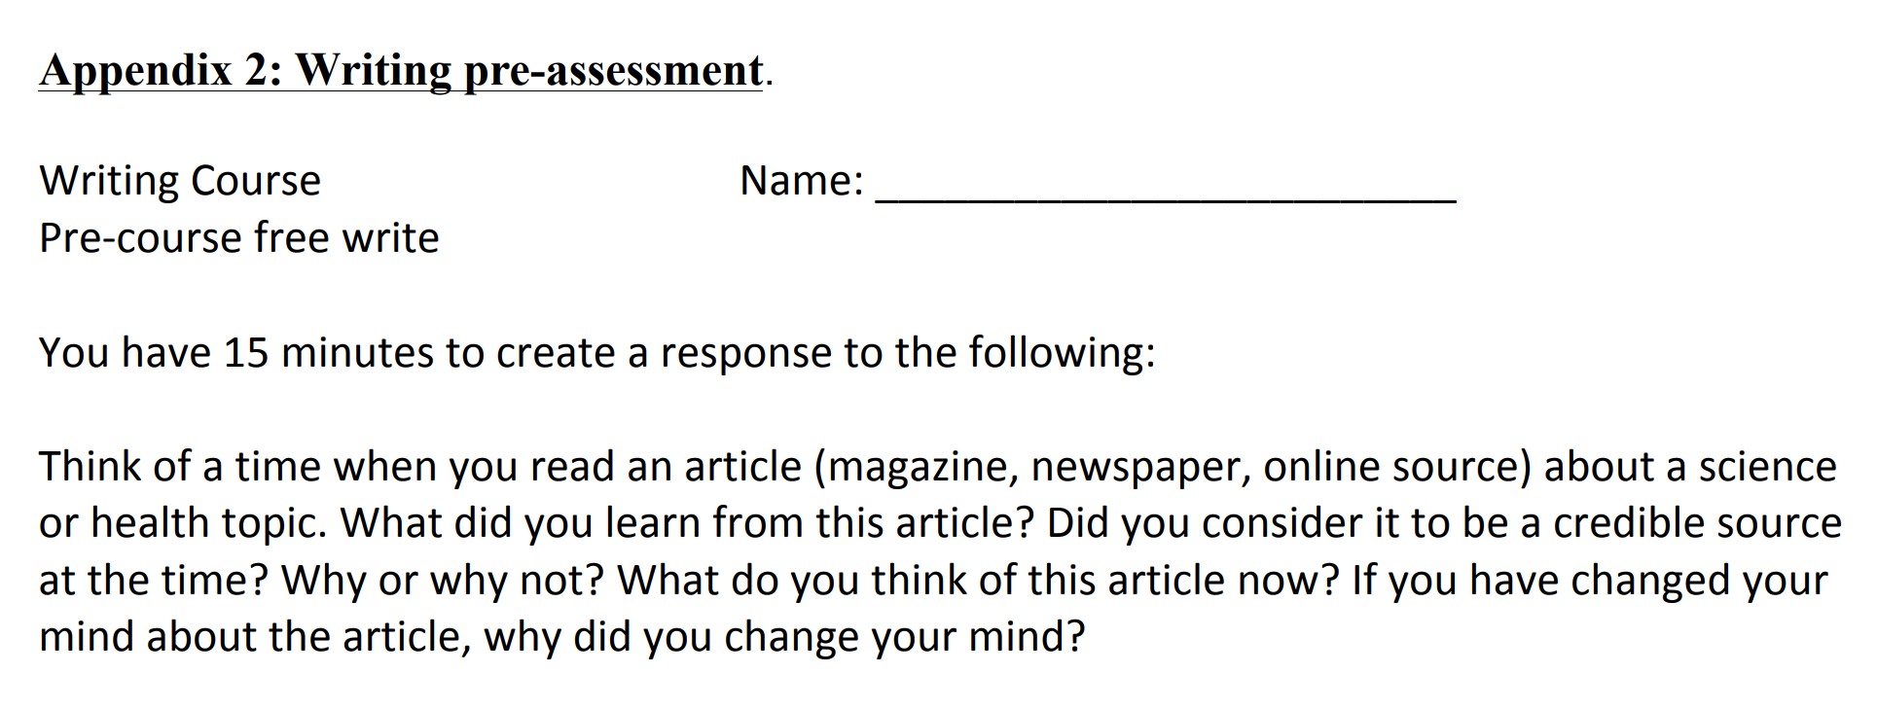

Slide 16
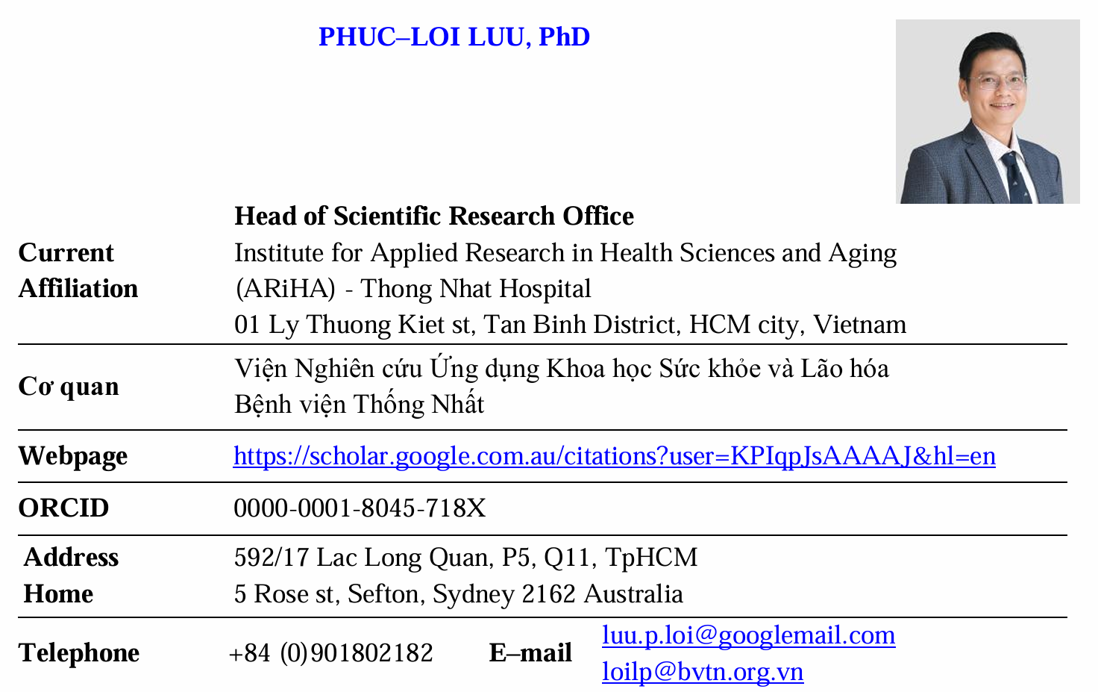

Slide 17
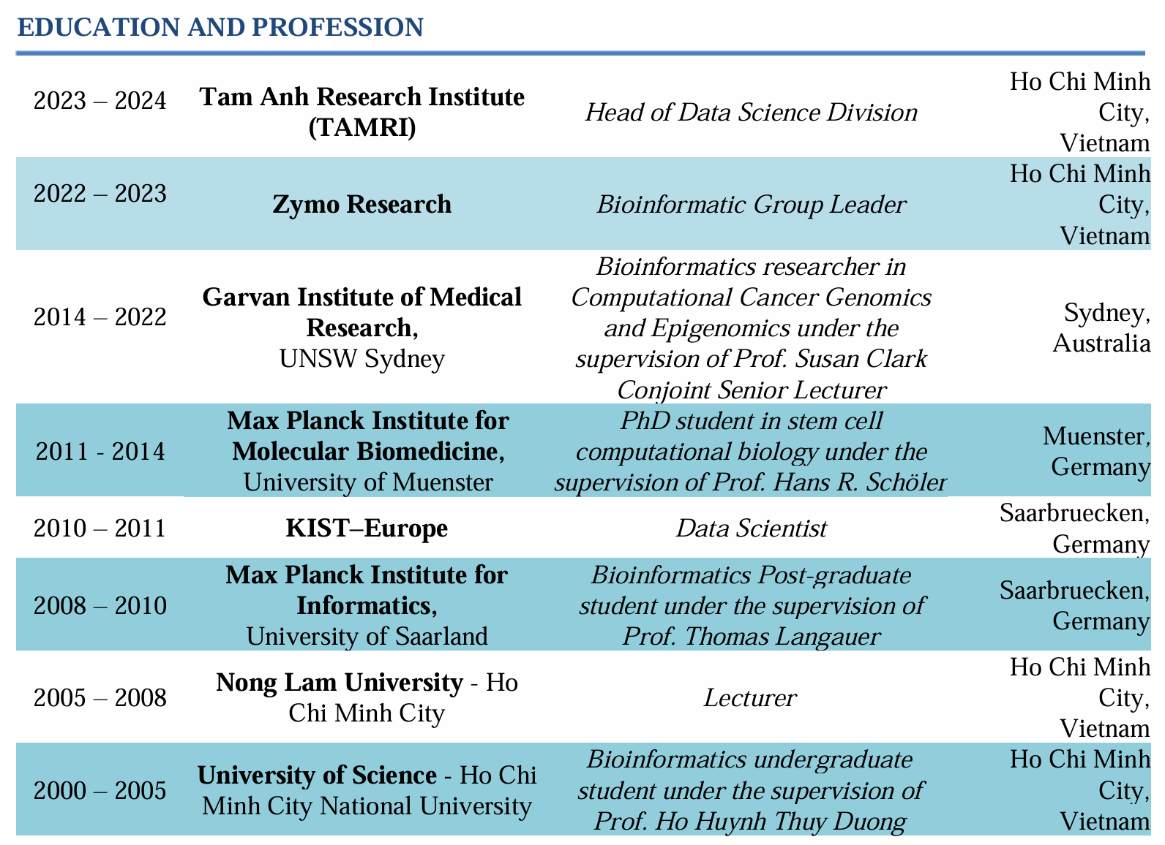
EDUCATION AND PROFESSION

Slide 18
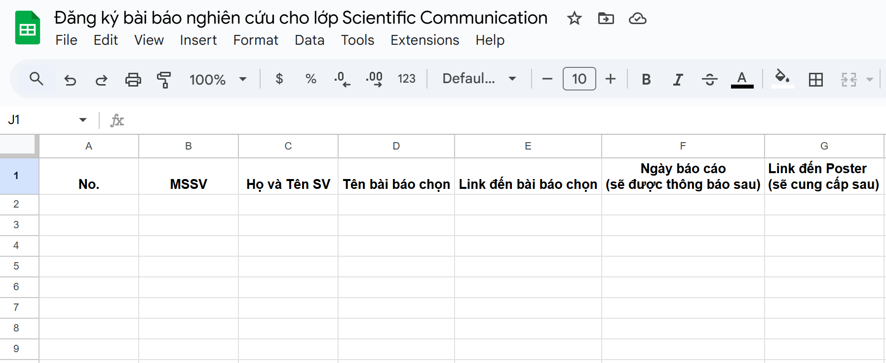
Projects
https://docs.google.com/spreadsheets/d/12YpEbNySqHpNNADEDEMcw-C-NgWBQZ193iHrRU0h5Js/edit?usp=sharing

Slide 19
How does my lecture work?
Start at 8:00 AM every Saturday and Sunday
1:30 PM every Saturday and Sunday
Time breaks in a lecture (30 min)
Lecture end at 11 AM
16:30 PM
No attendance checking

Slide 20
